Slide 1
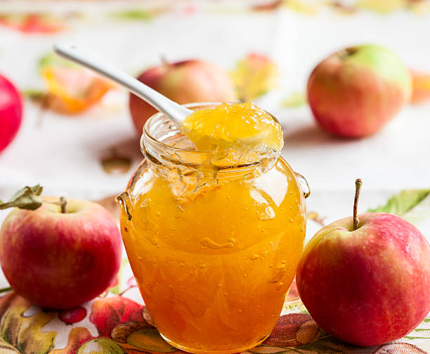
PROJECT ON ENTREPRENEUR
PATRA APPLE JAM PVT. LTD.
GUIDED BY:-
PRESENTED BY:-
DR. APURBA GIRI¹(HOD)
AYAN MONDAL² (ASSISTANT PROFESSOR)
DEPARTMENT OF NUTRITION
MR. DEBABRATA PATRA
DEPARTMENT OF NUTRITION
B.Voc (Food Processing,6TH Sem)

Slide 2
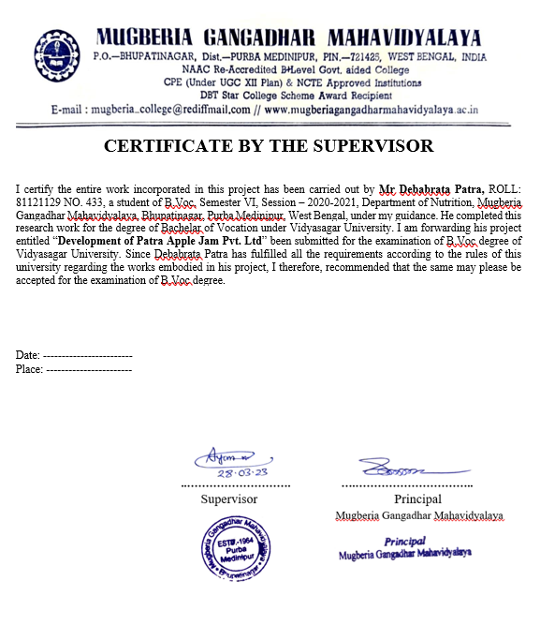

Slide 3
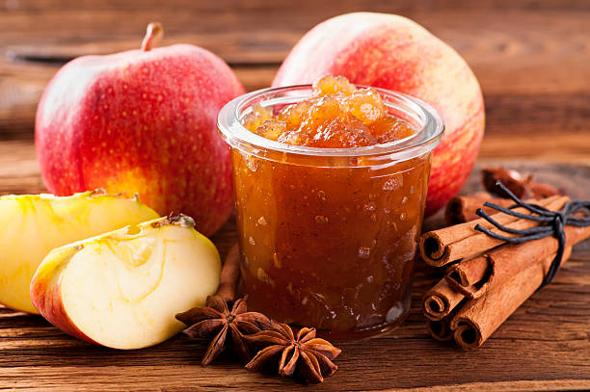
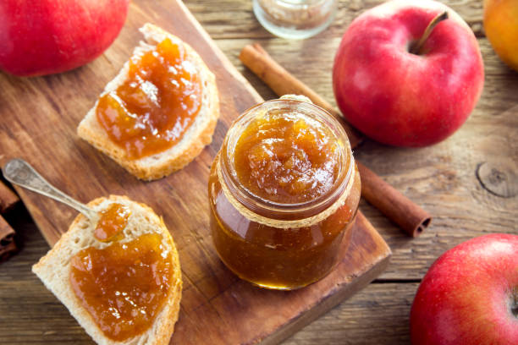
APPLE MANUFACTURING BUSINESS
WHY DO WE USE APPLE JAM AS SUCH?
BUSINESS RESEARCH
MACHINERY
INVESTMENT
RAW MATERIALS
TARGETED CUSTOMERS
JUDGEMENT OF END POINT
AREA & MANPOWER
PROFIT
LICENSES
MARKET STRATEGY
REWARD AND PUNISHMENT
PLANT LAYOUT

Slide 4
WHY DO WE USE APPLE JAM AS SUCH?
Apple (Malus domestica) is commercially the most important temperate fruit and is fourth among the most widely produced fruits in the world after banana, orange and grape. Jam means the product prepared from sound, ripe, fresh, dehydrated, frozen or previously packed fruits including fruit juices, fruit pulp, fruit juice concentrate or dry fruit by boiling. Its pieces or pulp or puree with nutritive sweeteners namely sugar, dextrose, invert sugar or liquid glucose to a suitable consistency. It may also contain fruit pieces and any other ingredients suitable to the products.

Slide 5
BUSINESS RESEARCH
DEMAND
SUPPLY
PRICE
QUALITY
QUANTITY

Slide 6
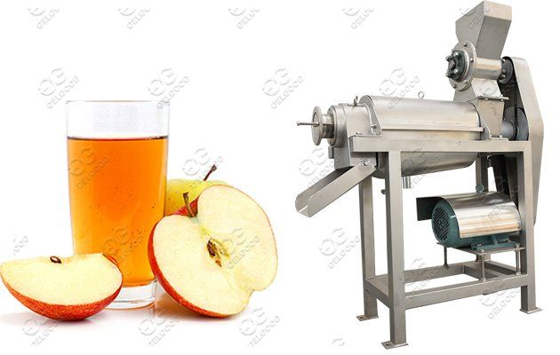
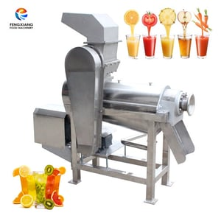
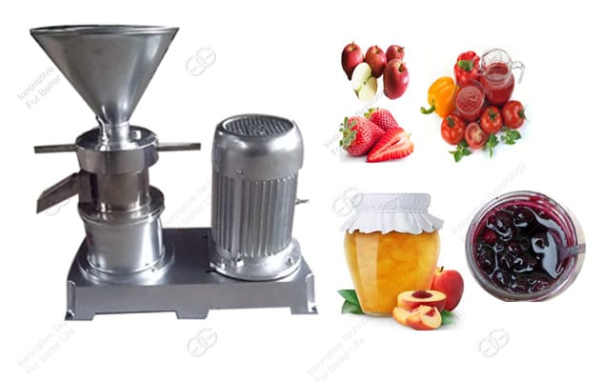
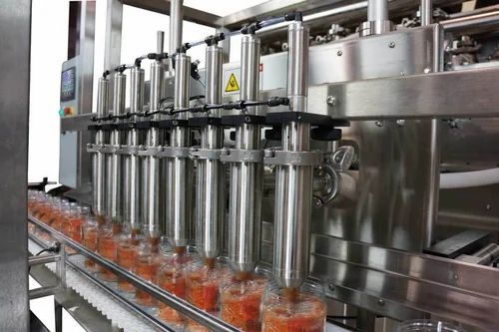
MACHINERY
Jam Production Requires:
Pulping Machine
Slice Machine
Baby Boiler
Grinder
Bottle Filling Machine
Bottle Washing Machine
Cap Sealing Equipment
Weighing Scales
Stirrers
Hand Gloves
Ss Utensils
Burner
Test Equipment An another equipment

Slide 7
Capital 12-15 Lakhs

Slide 8
RAW MATERIALS
Apple
Water
Sugar
Bottle (plastic+glass)
Preservatives & Flavours

Slide 9
MANUFACTURING FLOW CHART
Selection of ripened apple
Bottling, labelling , and storage
Washing
Removal of skin, pulping (colloidal Mill)and filtering
Filling hot into sterilized bottles
Addition of sugar(sugar and pectin –dissolved in little water )
Addition of preservative and colour (for commercial purpose )
Boiling with continuous stirring, Addition of citric acid
judging end point by further cooking (105°temp, 65° brix, sheet test & drop test )

Slide 10
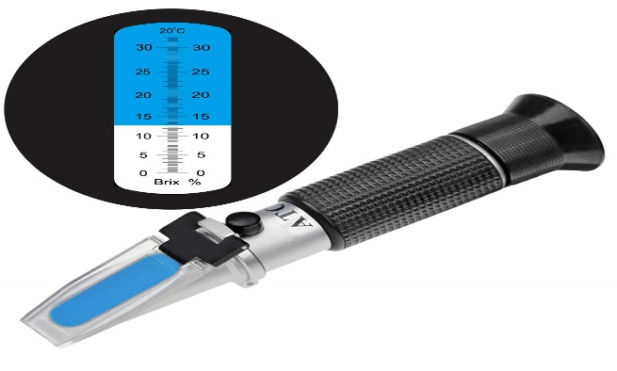
JUDGEMENT OF END POINT
Drop Test : A Drop of hot jam is put into a beaker of water and if the mass remains as remains as one and undispersed – the jam is done
Sheet Test : A spoon of jam is dropped from a distance on to a plate and if it falls down as a sheet – jam is done
Brix test: BY a refract meter

Slide 11
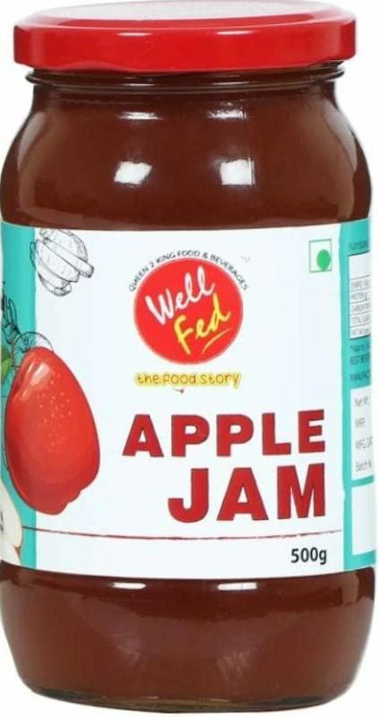
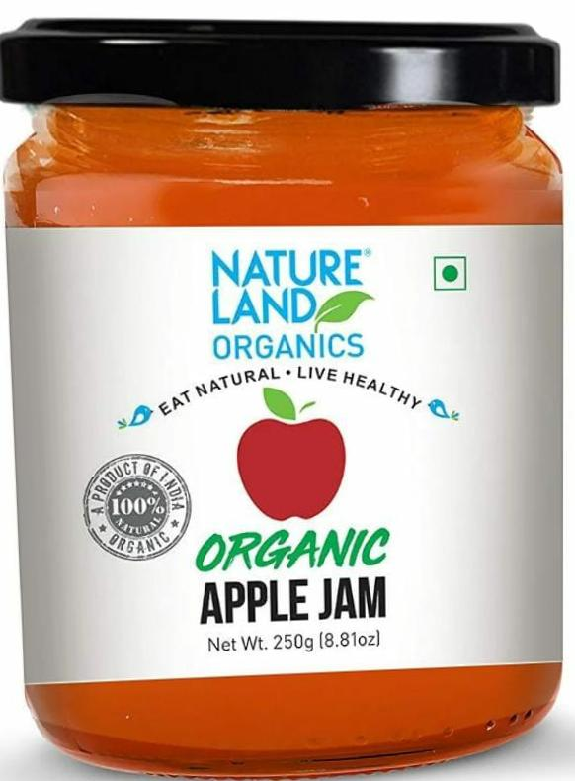
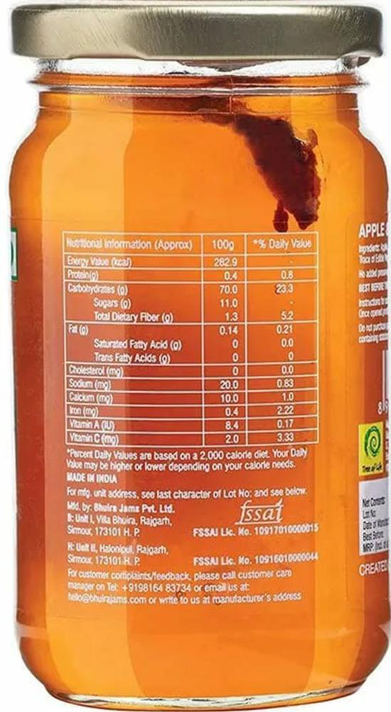
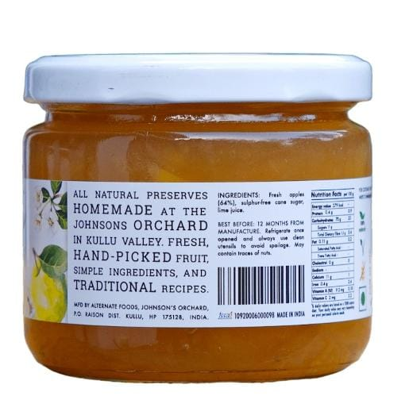
Packaging sizes:-

Slide 13
1500-2000 sQ.FT
10-12 LABOURS

Slide 15
LICENSES
REGISTRATION OF BUSINESS
NOC PAPER(FORM STATE POLLUTION CONTROL,SOUND AND WATER)
TRADE LICENSE
GST(Goods & Service Tax)
FSSAI(Food Safety and Standards Authority of India)
IEC CODE
REGISTRATION FOR TRADEMARK

Slide 16
MARKET STRATEGY
Firstly, Local Market Announcement
Secondary, Advertising
Thirdly, Sales Promotion
Fourth, Direct Marketing
Fifth, Digital Marketing

Slide 17
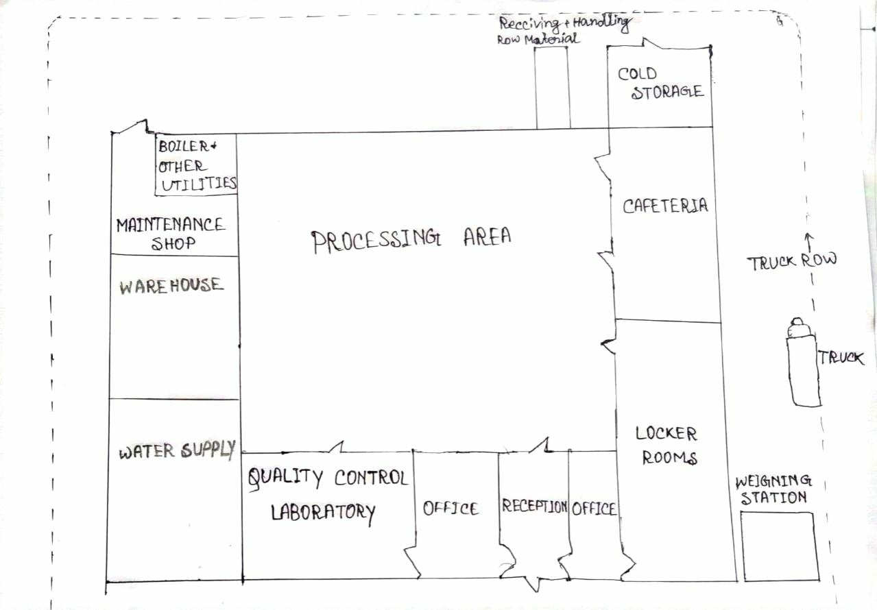
PLAN LAY OUT:

Slide 18
THANK YOU

